Slide 1
HOSPITAL MANAGEMENT SYSTEM
CMPE341- Database Design and Management Project
Group Members:
Furkan BABUCCU
Muhlis Erdem YILDIZ
Saime İpek İŞÇELEBİ

Slide 2
DATABASE FOR HOSPITAL MANAGEMENT SYSTEM
Entities in this database: Patient, doctor, department, hospital attendant, hospital, appointment, prescription, and pharmacy
Doctors should be able to add new data about patients to the database system.
Doctors should be able to view patients' historical data in the database system.
The hospital attendant should be able to add new patients to the database system.
Pharmacies should be able to see the prescriptions given to the patients through their system from the database.
The patient should be able to make an appointment before going to the hospital.
Patients have their own name, surname, date of birth (operation needed for calculating age), address, unique phone number, unique e-mail address, payment information(s), unique examination number, unique prescription number, and unique SSN.
Doctors have their own name, surname, date of birth, address, unique phone number, unique e-mail address, salary, department, unique SSN and unique doctor id.

Slide 3
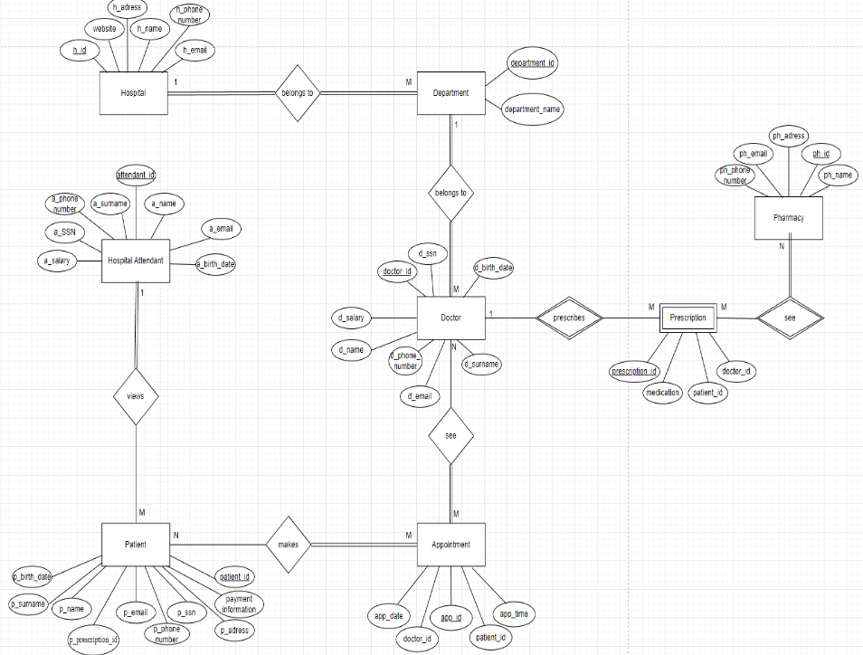
CONCEPUTAL DESIGN

Slide 4
LOGICAL DESIGN
Patient[patient_id, p_SSN, p_name, p_surname, p_email, p_birth_date, p_phone_number, payment_information, p_prescription_id, p_adress, app_id (FK refers to Appointment)]
Doctor[doctor_id, d_SSN, d_name, d_surname, d_phone _number, d_email, d_salary, d_birth_date, department_id ( FK refers to Department)]
Department[department_id, department_name, h_id ( FK refers to Hospital)]
Hospital_Attendant[attendant_id, a_SSN, a_name, a_surname, a_phone_number, a_email, a_birth_date, a_salary]
Hospital[h_id, h_name, h_address, h_email, website, h_phone_number]
Appointment[app_id, app_date, app_time, doctor_id(FK refers to Doctor), patient_id (FK refers to Patient)]
Prescription[prescription_id, patient_id (FK refers to Patient), doctor_id ( FK refers to Doctor), medication]
Pharmacy[ph_id, ph_name, ph_address, ph_email, ph_phone_number]
Makes[patient_id( FK refers to Patient), app_id( FK refers to Appointment)]
See[app_id ( FK refers to Appointment), doctor_id( FK refers to Doctor)]

Slide 5
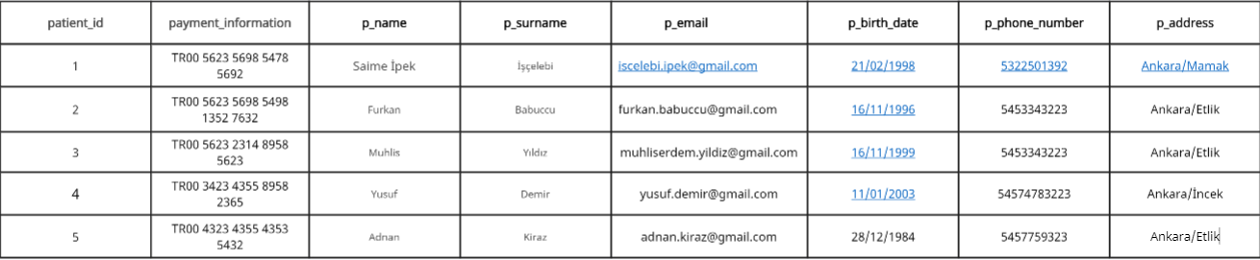
PHYSICAL DESIGN
For Patient Table we normalized tables:
Insert into Patient_Hospital_Information values(1,’TR00 5623 5698 5478 5692’,’Saime İpek’,’ İşçelebi’,’Iscelebi.ipek@gmail.com’,’21.02.1998’,’5322501392’,’Ankara/Mamak’);
Insert into Patient_Hospital_Information values(2,’TR00 5623 5698 5498 1352 7632’,’Furkan’,’ Babuccu’,’Furkan.babuccu@gmail.com’,’16.11.1999’,’5453343223’,’Ankara/Etlik’);
Insert into Patient_Hospital_Information values(3,’TR00 5623 2314 8958 5623’,’Muhlis Erdem’,’ Yıldız’,’Muhliserdem.yildiz@gmail.com’,’16.11.1999’,’5453343223’,’Ankara/Etlik’);
Insert into Patient_Hospital_Information values(4,’TR00 3423 4355 8958 2365,Yusuf’,’ Demir’,’Yusuf.demir@gmail.com’,’11.01.2003’,’54574783223’,’Ankara/İncek’);
Insert into Patient_Hospital_Information values(5,’TR00 4323 4355 4353 5432,Adnan’,’ Kiraz’,’Adnan.kiraz@gmail.com’,’28.12.1984’,’5457759323’,’Ankara/Etlik’);
Create table Patient_Hospital_Information (
patient_id int primary key,
payment_information varchar(24),
p_name varchar(20),
p_surname varchar(20),
p_email varchar(40),
p_birth_date varchar(10),
p_phone_number varchar(10),
p_adress varchar(50)
);

Slide 6
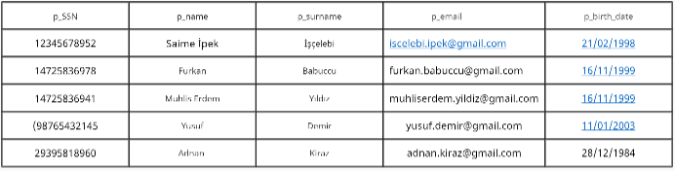
Create table Patient_Personal_Information ( p_SSN varchar(11), p_name varchar(20), P_surname varchar(20), P_email varchar(40), P_birth_date varchar(10) );
Insert into Patient_Personal_Information values(‘12345678952’,’Saime İpek’, ’İşçelebi’ ,’Iscelebi.ipek@gmail.com’, ‘21.02.1998’);
Insert into Patient_Personal_Information values(14725836978,’Furkan’,’ Babuccu’,’Furkan.babuccu@gmail.com’,’16.11.1999’);
Insert into Patient_Personal_Information values(14725836941,’Muhlis Erdem’,’ Yıldız’,’Muhliserdem.yildiz@gmail.com’,’16.11.1999’);
Insert into Patient_Personal_Information values(98765432145,’Yusuf’,’ Demir’,’Yusuf.demir@gmail.com’,’11.01.2003’);
Insert into Patient_Personal_Information values(29395818960, ‘Adnan’,’ Kiraz’,’Adnan.kiraz@gmail.com’,’ 28.12.1984’);

Slide 7
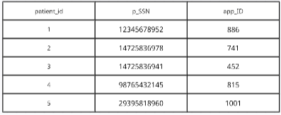
Create table Patient_Appointment( patient_id int primary key, p_SSN varchar(11), App_id int, foreign key(app_id) references Appointment(app_id) );
Insert into Patient_Appointment values (1, ’12345678952’, 886)
Insert into Patient_Appointment values (2, ’14725836978’, 741)
Insert into Patient_Appointment values (3, ’14725836941’, 452)
Insert into Patient_Appointment values (4, ’98765432145’, 815)
Insert into Patient_Appointment values (5, ’29395818960’,1001)

Slide 8
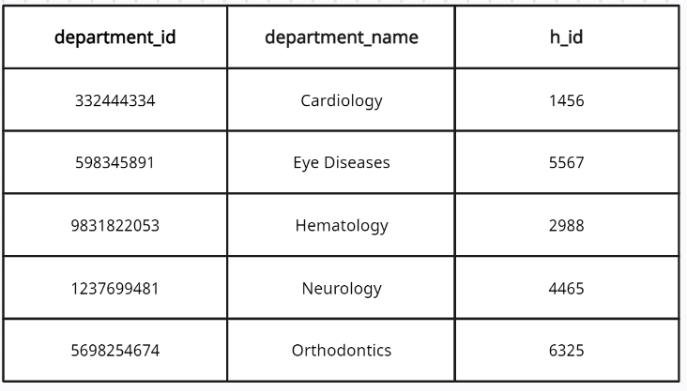
For Department Table:
Create Table Department(
department_id int primary key,
department_name varchar(15),
H_id int,
Foreign key(h_id) references Hospital (h_id)
);
Insert into Department values ( 332444334, ‘Cardiology’, 1456);
Insert into Department values ( 598345891, ‘Eye Diseases’, 5567);
Insert into Department values ( 9831822053, ‘Hematology’, 2988);
Insert into Department values ( 1237699481, ‘Neurology’, 4465);
Insert into Department values ( 5698254674, ‘Orthodontics’, 6325);

Slide 9
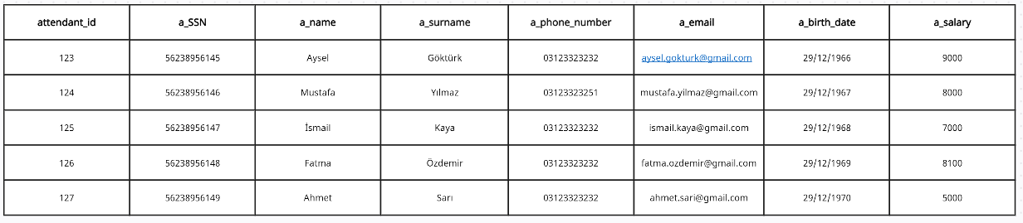
For Hospital Attendant Table:
Create Table Hospital_Attendant(
attendant_id int primary key,
a_SSN varchar(11),
a_name varchar(20),
a_surname varchar(20),
a_phone_number varchar(10),
a_email varchar(50),
a_birthdate varchar(10),
a_salary int
);
Insert into Hospital_Attendant values (123, ‘56238956145’, ‘Aysel’, ‘Göktürk’, ‘5322639584’, ‘aysel.gokturk@gmail.com’, ‘29/12/1966’, 9000);
Insert into Hospital_Attendant values (124, '56238956146', 'Mustafa', 'Yılmaz', '5322639585', 'mustafa.yilmaz@gmail.com', '29/12/1967', 8000);
Insert into Hospital_Attendant values((125, '56238956147', 'İsmail', 'Kaya', '5322639586', 'ismail.kaya@gmail.com', '29/12/1968', 7000);
Insert into Hospital_Attendant values (126, '56238956148', 'Fatma', 'Özdemir', '5322639587', 'fatma.ozdemir@gmail.com', '29/12/1969', 8100);
Insert into Hospital_Attendant values (127, '56238956149', 'Ahmet', 'Sarı', '5322639588', 'ahmet.sari@gmail.com', '29/12/1970', 5000);

Slide 10
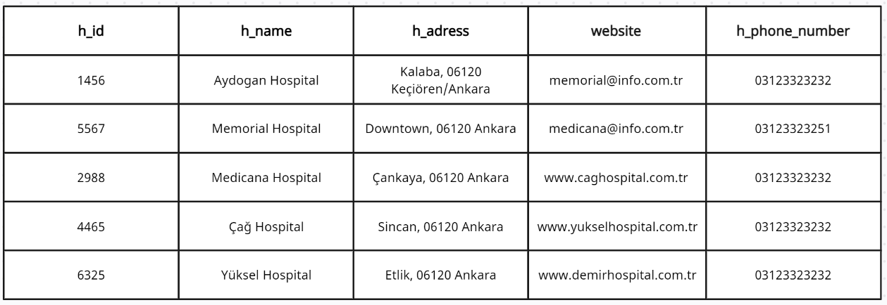
For Hospital Table:
Create Table Hospital(
h_id int primary key,
h_name varchar(20),
h_address varchar(50),
website varchar(20),
h_phone_number varchar(20)
);
Insert into Hospital values( 1456, ‘Aydogan Hospital’, ‘Kalaba, 06120 Keçiören/Ankara’, ‘aydogan@info.com.tr’, ‘www.aydoganhospital.com.tr’ , ‘03123323232’);
Insert into Hospital values (5567, 'Memorial Hospital', 'Downtown, 06120 Ankara', 'memorial@info.com.tr', 'www.memorialhospital.com.tr', '03123323251');
Insert into Hospital values (2988, 'Medicana Hospital', 'Çankaya, 06120 Ankara', 'medicana@info.com.tr', 'www.medicanahospital.com.tr', '03123323232');
Insert into Hospital values (4465, 'Çağ Hospital', 'Sincan, 06120 Ankara', 'caghospital@info.com.tr', 'www.caghospital.com.tr', '03123323232');
Insert into Hospital values (6325, 'Yüksel Hospital', 'Etlik, 06120 Ankara', 'yuksel@info.com.tr', 'www.yukselhospital.com.tr', '03123323232');

Slide 11
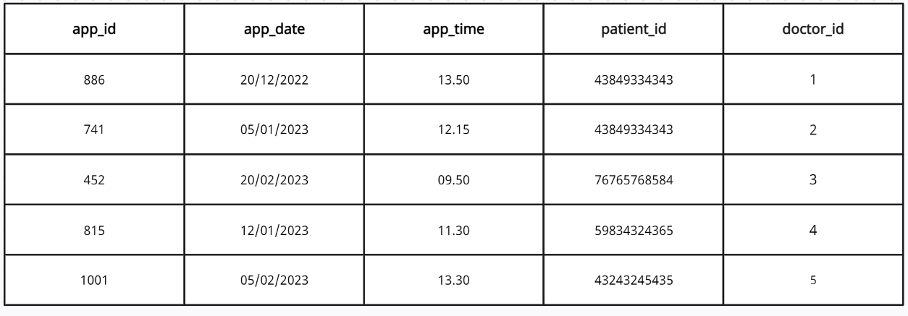
For Appointment Table:
Create Table Appointment(
app_id int primary key,
app_date varchar(10),
app_time varchar(5),
patient_id int,
doctor_id int,
Foreign key(patient_id) references patient_hospital_information (patient_id),
Foreign key(doctor_id ) references doctor_hospital_information (doctor_id)
);
Insert into Appointment values (886, ‘20/12/2022’, ‘13.50’, 43849334343, 1);
Insert into Appointment values (741, ‘05/01/2023’, ‘12.15’, 43849334343, 2);
Insert into Appointment values (452, ‘20/02/2023’, ‘09.50’, 7676576858, 3);
Insert into Appointment values (815, ‘12/01/2023’, ‘11.30’, 59834324365, 4);
Insert into Appointment values (1001, ‘05/02/2023’, ‘13.30’, 43243245, 5);

Slide 12
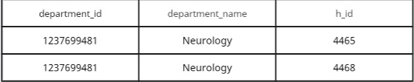
PHYSICAL DESIGN QUERIES
1. Display data from multiple tables (join)
Display the department ID, department name, hospital ID, and hospital name where department name is ‘Neurology’.
Select d.department_id, d.department_name, h.h_id, h.hospital_name
From department d, hospital h
Where d.h_id = h.h_id
And department_name = ‘Neurology’;

Slide 13
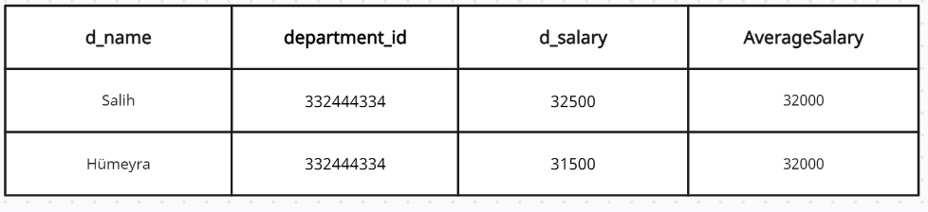
2. Group By Statements
Display the department ID, doctor salary, average salary (rename as AverageSalary) by grouping department ID.
Select do.d_name,do.department_id, do.d_salary, AVG(do.d_salary) as AverageSalary
From doctor_hospital_information do, department de
Where do.department_id = de.department_id
And department_id = ‘332444334’
Group By department_id;

Slide 14
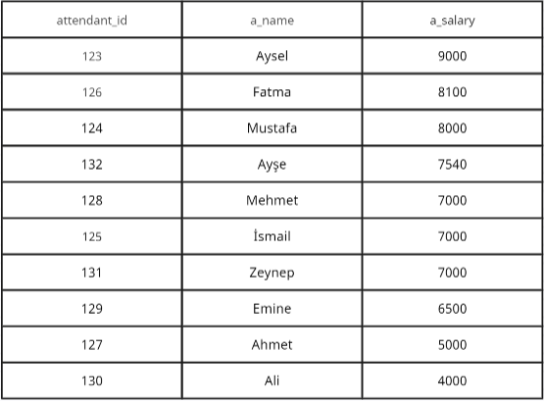
3. Group By / Order By statements
Display the attendant ID,attendant name, attendant salary in descending order
Select attendant_id, a_name, a_salary
From hospital_attendant
Order By Salary DESC;

Slide 15
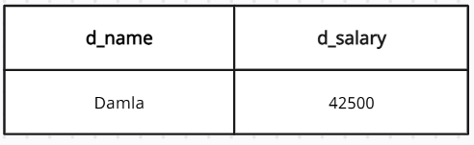
4. Subquery
Display the department name, doctor salary which greater than Damla’s salary
Select d_name, d_salary
From doctor_hospital_information
Where d_salary > all (
Select d_salary
From doctor_hospital_information
Where d_name = ‘Damla’
);

Slide 16
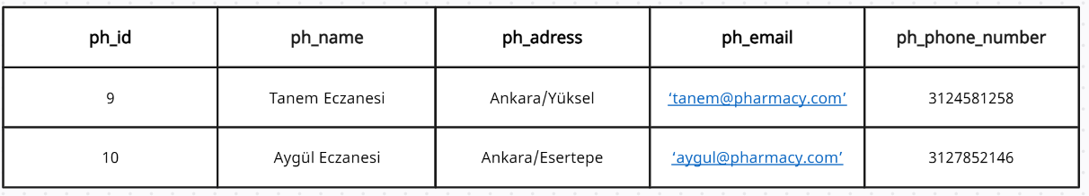
5. Select All Entities
Display all entities about pharmacy table which has pharmacy ID greater than 500
Select *
From pharmacy
Where ph_id > 500;

Slide 17
THANK YOU ☺

